Slide 1
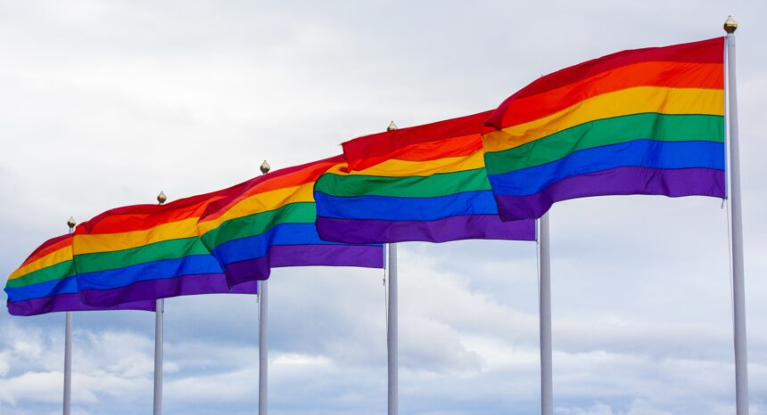
THE LGBTQ IMPACT
This Photo by Unknown Author is licensed under CC BY-ND

Slide 2
Importance of discussing this topic:
Recognising and understanding
Examining the issues
Impact on human rights
Impact on work place
LGBTQ+
Lesbians
Gay
Bisexual
Transgender
Questioning
Why this topic?:
Relevance
Diversity and Inclusion
Ethical Consideration
Innovation Educational Values
Unethical issues faced by LGBTQ
Difference between sex and gender
Theoretical background
Ethical issues faced by LGBTQ
Data of LGBTQ
Challenges:
Workplace discrimination
Lack of representation
PRIDE MONTH

